Slide 1
Queues
Chapter 6
Nyhoff, ADTs, Data Structures and Problem Solving with C++, Second Edition, © 2005 Pearson Education, Inc. All rights reserved. 0-13-140909-3

Slide 2
Chapter Contents
8.1 Introduction to Queues
8.2 Designing and Building a Queue Class – Array Based
8.3 Linked Queues
8.4 Application of Queues: Buffers and Scheduling
8.5 Case Study: Center Simulation
Nyhoff, ADTs, Data Structures and Problem Solving with C++, Second Edition, © 2005 Pearson Education, Inc. All rights reserved. 0-13-140909-3

Slide 3
Chapter Objectives
To study a queue as an ADT
Build a static-array-based implementation of queues
Build a dynamic-array-based implementation of queues
Show how queues are used in I/O buffers and scheduling in a computer system
(Optional) See how queues are used in simulations of phenomena that involve waiting in lines
Nyhoff, ADTs, Data Structures and Problem Solving with C++, Second Edition, © 2005 Pearson Education, Inc. All rights reserved. 0-13-140909-3

Slide 4

Introduction to Queues
A queue is a waiting line – seen in daily life
  A line of people waiting for a bank teller
  A line of cars at a toll both
  "This is the captain, we're 5th in line for takeoff"
What other kinds of queues can you think of
Nyhoff, ADTs, Data Structures and Problem Solving with C++, Second Edition, © 2005 Pearson Education, Inc. All rights reserved. 0-13-140909-3

Slide 5
The Queue As an ADT
A queue is a sequence of data elements
In the sequence
  Items can be removed only at the front
  Items can be added only at the other end, the back
Basic operations
  Construct a queue
  Check if empty
  Enqueue (add element to back)
  Front (retrieve value of element from front)
  Dequeue (remove element from front)
Nyhoff, ADTs, Data Structures and Problem Solving with C++, Second Edition, © 2005 Pearson Education, Inc. All rights reserved. 0-13-140909-3

Slide 6
Example: Drill and Practice Problems
We seek a program to present elementary math problems to students
They are presented with a problem where they combine randomly generated integers
When they respond and are
  Successful – proceed to another problem
  Unsuccessful – problem stored for asking again later
The program will determine the number of problems and largest values used in the operation
Then it will generate that many problems and place them in the problem queue
Nyhoff, ADTs, Data Structures and Problem Solving with C++, Second Edition, © 2005 Pearson Education, Inc. All rights reserved. 0-13-140909-3

Slide 7
Example: Drill and Practice Problems
For now, we will assume a queue class
Note declaration of the AdditionProblem class, Fig 8.1A
Implementation, AdditionProblem.cpp, Fig 8.1B
View source code of drill and practice program, Fig. 8.1C
Nyhoff, ADTs, Data Structures and Problem Solving with C++, Second Edition, © 2005 Pearson Education, Inc. All rights reserved. 0-13-140909-3

Slide 8

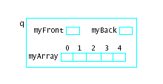
Designing and Building a Queue Class Array-Based
Consider an array in which to store a queue
Note additional variables needed
  myFront, myBack
Picture a queue
object like this
Nyhoff, ADTs, Data Structures and Problem Solving with C++, Second Edition, © 2005 Pearson Education, Inc. All rights reserved. 0-13-140909-3

Slide 9
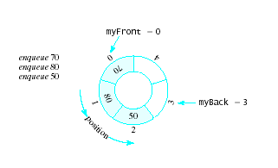
Designing and Building a Queue Class Array-Based
Problems
  We quickly "walk off the end" of the array
Possible solutions
  Shift array elements
  Use a circular queue
  Note that both empty
  and full queue
  gives myBack == myFront
Nyhoff, ADTs, Data Structures and Problem Solving with C++, Second Edition, © 2005 Pearson Education, Inc. All rights reserved. 0-13-140909-3

Slide 10
Designing and Building a Queue Class Array-Based
Using a static array
  QUEUE_CAPACITY specified
  Enqueue increments myBack using mod operator, checks for full queue
  Dequeue increments myFront using mod operator, checks for empty queue
Note declaration of Queue class, Fig 8.2A
View implementation, Fig. 8.2B
Nyhoff, ADTs, Data Structures and Problem Solving with C++, Second Edition, © 2005 Pearson Education, Inc. All rights reserved. 0-13-140909-3

Slide 11
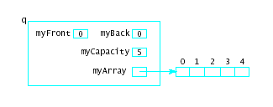
Using Dynamic Array to Store Queue Elements
Similar problems as with list and stack
  Fixed size array can be specified too large or too small
Dynamic array design allows sizing of array for multiple situations
Results in structure as shown
  myCapacity
  determined
  at run time
Nyhoff, ADTs, Data Structures and Problem Solving with C++, Second Edition, © 2005 Pearson Education, Inc. All rights reserved. 0-13-140909-3

Slide 12
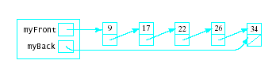
Linked Queues
Even with dynamic allocation of queue size
  Array size is still fixed
  Cannot be adjusted during run of program
Could use linked list to store queue elements
  Can grow and shrink to fit the situation
  No need for upper bound (myCapacity)
Nyhoff, ADTs, Data Structures and Problem Solving with C++, Second Edition, © 2005 Pearson Education, Inc. All rights reserved. 0-13-140909-3

Slide 13

Linked Queues
Constructor initializes
myFront, myBack
Front
  return myFront->data
Dequeue
  Delete first node (watch for empty queue)
Enqueue
  Insert node at end of list
View LQueue.h declaration, Fig 8.3A
Note definition, LQueue.cpp, Fig 8.3B
Driver program, Fig. 8.3C
Nyhoff, ADTs, Data Structures and Problem Solving with C++, Second Edition, © 2005 Pearson Education, Inc. All rights reserved. 0-13-140909-3

Slide 14


Circular Linked List
Possible to treat the linked list as circular
  Last node points back to first node
  Alternatively keep pointer to last node rather than first node
Nyhoff, ADTs, Data Structures and Problem Solving with C++, Second Edition, © 2005 Pearson Education, Inc. All rights reserved. 0-13-140909-3

Slide 15
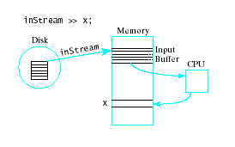
Application of Queues: Buffers and Scheduling
Important use of queues is I/O scheduling
  Use buffers in memory to improve program execution
  Buffer arranged
  in FIFO
  structure
Nyhoff, ADTs, Data Structures and Problem Solving with C++, Second Edition, © 2005 Pearson Education, Inc. All rights reserved. 0-13-140909-3

Slide 16
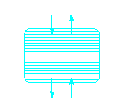
Application of Queues: Buffers and Scheduling
Also times when insertions, deletions must be made from both ends
  Consider a scrolling
  window on the screen
This requires a double
ended queue
  Called a deque (pronounced "deck")
  Could also be considered a double ended stack (or "dack")
Nyhoff, ADTs, Data Structures and Problem Solving with C++, Second Edition, © 2005 Pearson Education, Inc. All rights reserved. 0-13-140909-3

Slide 17
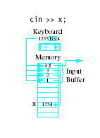
Application of Queues: Buffers and Scheduling
Consider a keyboard buffer
  Acts as a queue
  But elements may be
  removed from the back of
  the queue with
  backspace key
A printer spool is a queue of print jobs
Nyhoff, ADTs, Data Structures and Problem Solving with C++, Second Edition, © 2005 Pearson Education, Inc. All rights reserved. 0-13-140909-3

Slide 18
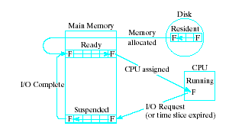
Application of Queues: Buffers and Scheduling
Queues used to
schedule tasks
within an operating
system
Job moves from disk to ready queue
Nyhoff, ADTs, Data Structures and Problem Solving with C++, Second Edition, © 2005 Pearson Education, Inc. All rights reserved. 0-13-140909-3

Slide 19
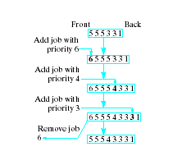
Application of Queues: Buffers and Scheduling
Ready queue may actually
be a priority queue … job may get to "cut the line" based on its priority
Nyhoff, ADTs, Data Structures and Problem Solving with C++, Second Edition, © 2005 Pearson Education, Inc. All rights reserved. 0-13-140909-3

Slide 20
Case Study: Information Center Simulation
Most waiting lines (queues) are dynamic
  Their lengths grow and shrink over time
Simulation models this dynamic process
  Enables study of the behavior of the process
  Modeled with one or more equations
Queue behavior involves randomness
  We will us pseudorandom number generator
Nyhoff, ADTs, Data Structures and Problem Solving with C++, Second Edition, © 2005 Pearson Education, Inc. All rights reserved. 0-13-140909-3

Slide 21
Problem Analysis and Specification
Consider an information center
  Calls arrive at random intervals
  Placed in queue of incoming calls
  When agent becomes available, services call at front of queue
We will simulate receipt of "calls" for some number of "minutes"
  we keep track of calls in the queue
Nyhoff, ADTs, Data Structures and Problem Solving with C++, Second Edition, © 2005 Pearson Education, Inc. All rights reserved. 0-13-140909-3

Slide 22
Problem Analysis and Specification
Input to the simulation program
  Time limit
  Arrival rate of calls
  Distribution of service times
Desired output
  Number of calls processed
  Average waiting time per call
Note declaration of Simulation class, Fig. 8-4
Nyhoff, ADTs, Data Structures and Problem Solving with C++, Second Edition, © 2005 Pearson Education, Inc. All rights reserved. 0-13-140909-3

Slide 23
Problem Analysis and Specification
Constructor
  Initialize input data members
  myTimer, myIncomingCalls initialized by their constructors
The run() method
  Starts and manages simulation
The checkForNewCall() method
  Random number generated, compared to myArrivalRate
  If new call has arrived, create new Call object, place in queue
Nyhoff, ADTs, Data Structures and Problem Solving with C++, Second Edition, © 2005 Pearson Education, Inc. All rights reserved. 0-13-140909-3

Slide 24
Problem Analysis and Specification
The service() method
  Checks time remaining for current call
  When done, retrieves and starts up next call from front of queue
The display() method
  Report generated at end of simulation
View definition of function members
Fig. 8-5A
Note driver program for simulation, Fig. 8-5B
Reference the Timer class and Call class used in the Simulation class
Nyhoff, ADTs, Data Structures and Problem Solving with C++, Second Edition, © 2005 Pearson Education, Inc. All rights reserved. 0-13-140909-3

